Slide 1
Helth Care Staffing Agency Data Analysis
File creato il: 5/21/2023 1:24:28 PM

Slide 2
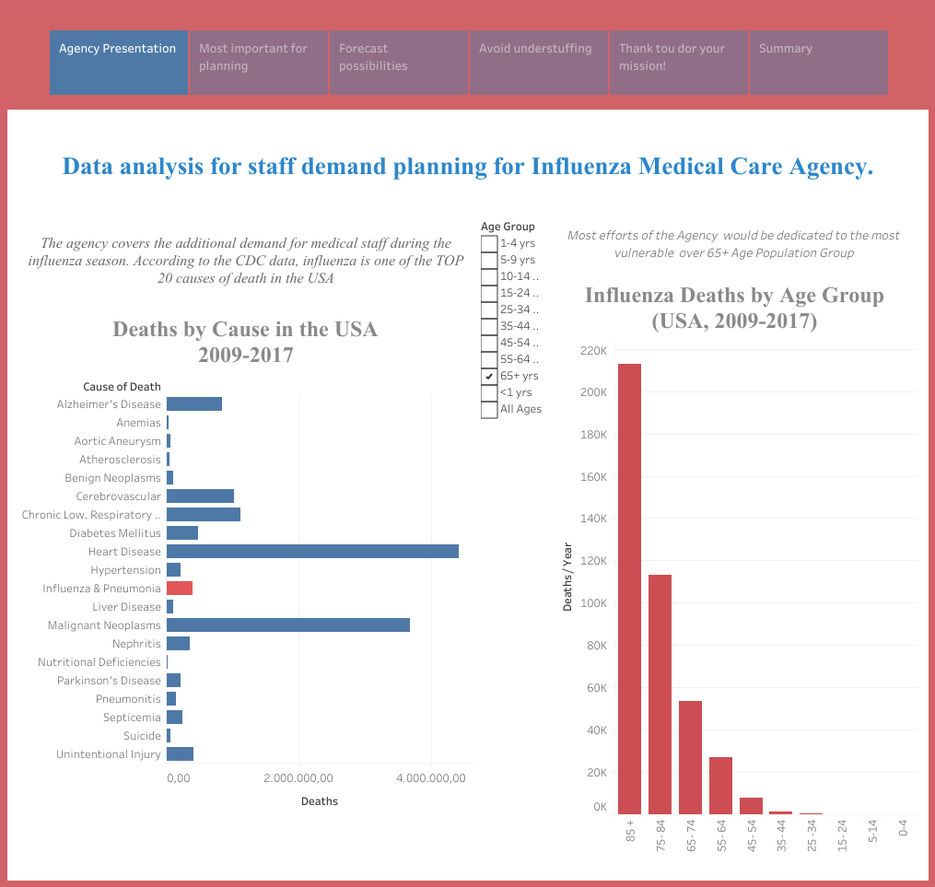

Slide 3
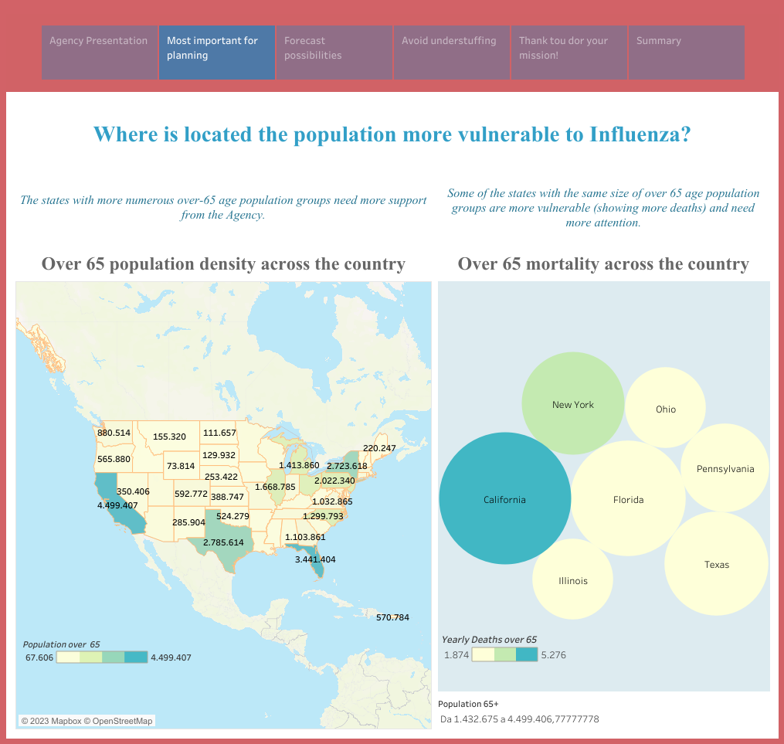

Slide 4
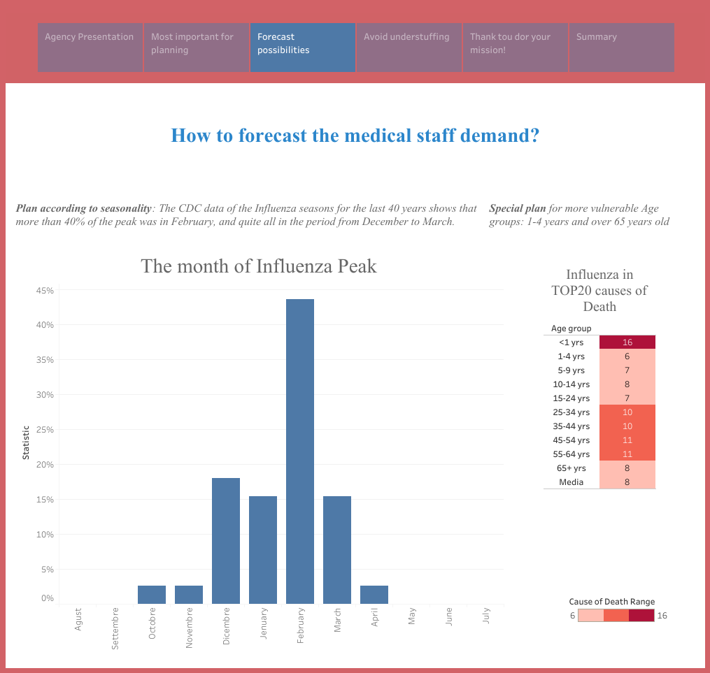

Slide 5
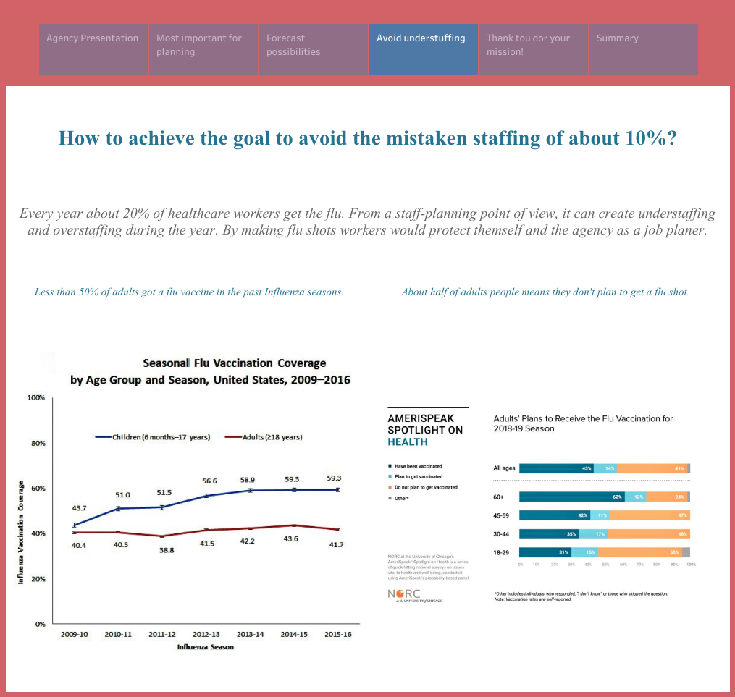

Slide 6
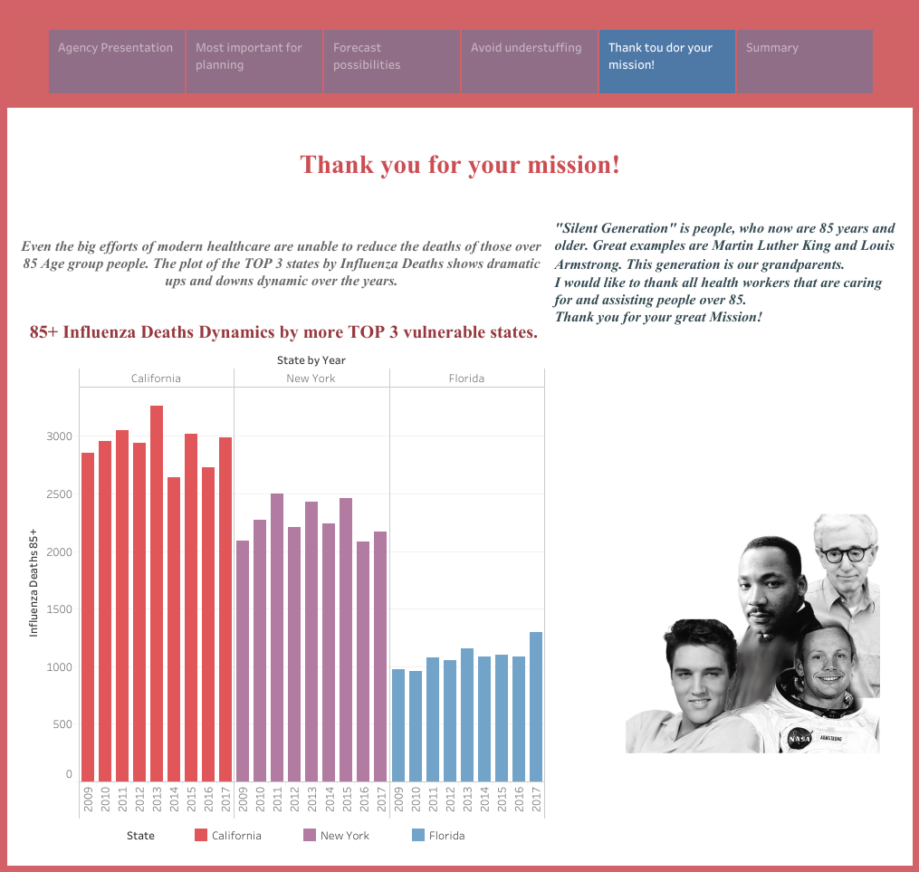

Slide 7
